Slide 1




EfficientSAM:
Leveraged Masked Image Pretraining for Efficient Segment Anything
- META AI Research
2024 IEEE/CVF Conference on Computer Vision and Pattern Recognition (CVPR)
Instructor:
Prof. C.K. Mohan
Teaching Assistant:
K R Anuraj
Presenter:
Isha Kumar
Presentation Part -2

Slide 2


Agenda Overview
01
Summary of Presentation 1
06
Challenges Faced
02
Datasets
07
Reproduced Results
03
Methodology
08
Limitations
04
Live Paper Results
09
Novelty & Results
05
Model Configuration
10
Conclusion & References

Slide 3

Summary of Presentation 1
Existing Models:
SAM:
Sets new benchmark with its zero-shot segmentation ability, achieving an AP of 46.5 on COCO dataset.
Uses a prompt-based ViT-H encoder, trained on SA-1B dataset with more than 1B masks from 11M images.
High Computational Cost: Employs a Vision Transformer (ViT-H) with 632 million parameters.
Difficult deployment in resource-constrained environments and it is infeasible for real-time applications due to its high computational demands.
FastSAM:
Improves efficiency (approx. 50 times faster than SAM) of SAM with a CNN architecture.
Achieves an AP of 37.9 on COCO, a decrease from SAM's performance.
MobileSAM:
Introduces a lightweight model (approx. 9.66 million parameters) via decoupled distillation.
Achieves an AP of 38.7 on COCO, a decrease from SAM's performance.

Slide 4
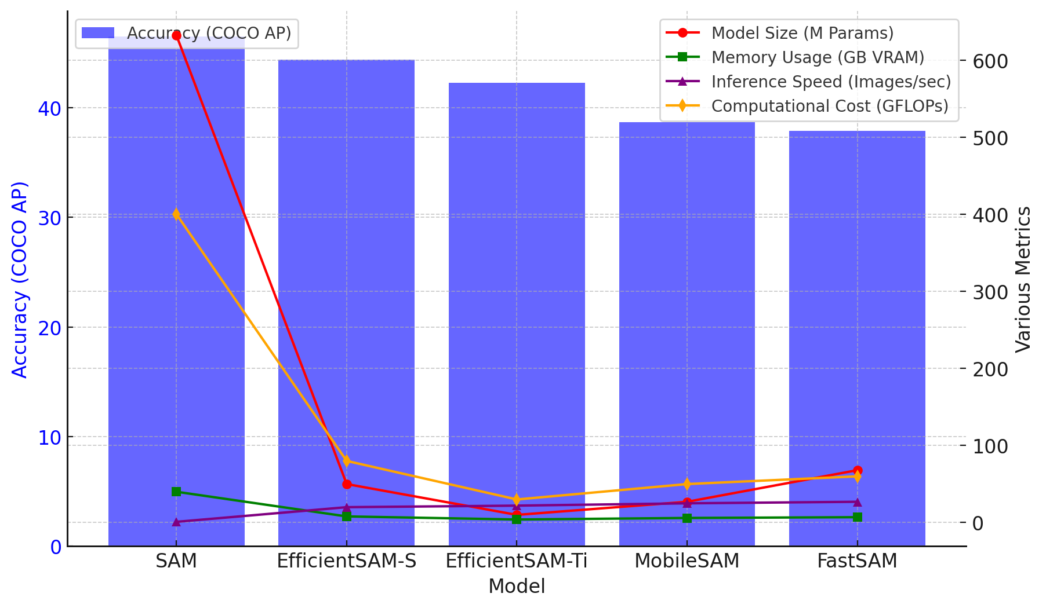
EfficientSAM
There are 2 versions of EfficientSAM:
EfficientSAM-Ti:
Parameters: Reduced to 9.8 million.
AP on COCO: Achieves 42.3
Inference Time: Approximately 20x faster than SAM.
EfficientSAM-S:
Parameters: 25 million (20x less than SAM)
AP on COCO: Achieves 44.4
Inference Time: Approximately 20x faster than SAM.
SAMI (SAM-leveraged Masked Image Pretraining) enables efficient learning and creates lightweight models for practical deployment.

Slide 5


Datasets
Dataset | Purpose | Details | Use in Research
ImageNet-1K | Image classification | 1.2M training images, 50K validation images across 1,000 different classes of objects, animals, and even scenes. | SAMI pretraining for lightweight ViT encoders.
SA-1B Segment Anything 1 Billion | Segment Anything task | 1B masks from 11M high-resolution images | Fine-tuning EfficientSAM for segmenting any object in an image.
COCO Common Objects in Context | Object detection & instance segmentation | 118K training images, 5K validation images | Fine-tuning & Evaluating EfficientSAM's performance for detection and segmentation tasks.
LVIS Large Vocabulary Instance Segmentation | Instance Segmentation | 160k images and 2M instance annotations, validation set has been expanded from 5k images to 20k images. | Evaluating EfficientSAM's performance IN zero-shot and point-based instance segmentation.

Slide 6
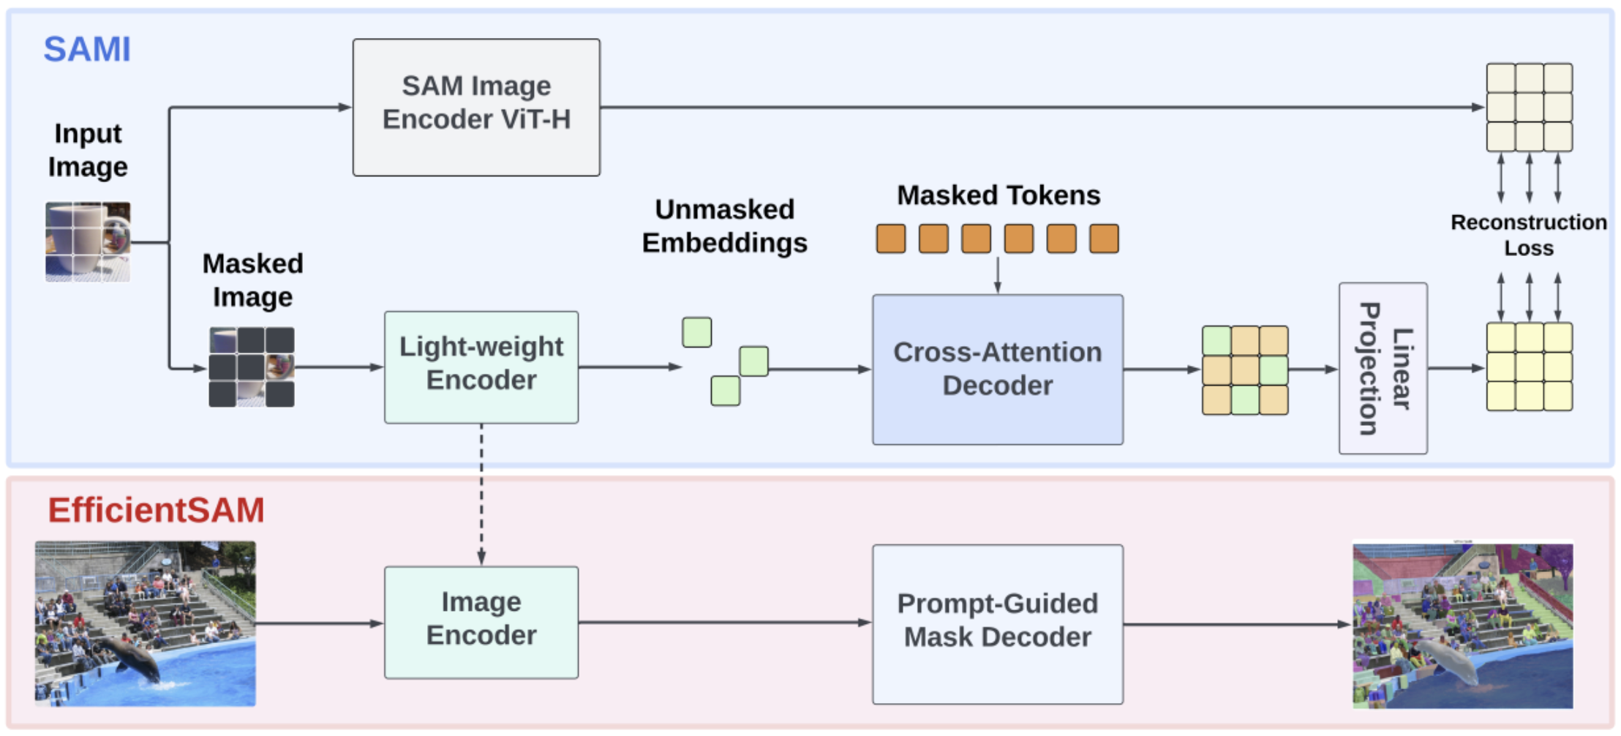
Methodology: SAMI Pretraining
Step 1: Input Image Processing
Input image is passed through the SAM Image Encoder (ViT-H).
The SAM Image Encoder extracts rich feature embeddings from the image.
A masked version of the image is also created, where parts of the image are hidden to train the model to reconstruct them.
The EfficientSAM framework consists of two key stages:
SAMI Pretraining (Top Blue Section)
EfficientSAM Fine-Tuning (Bottom Red Section)

Slide 7
Methodology: SAMI Pretraining
Step 2: Masked Autoencoder (MAE) Approach
The masked image is processed by a Lightweight Encoder.
The encoder extracts features from the visible (unmasked) tokens, while masked parts remain hidden.
The output consists of unmasked embeddings (green blocks).
The EfficientSAM framework consists of two key stages:
SAMI Pretraining (Top Blue Section)
EfficientSAM Fine-Tuning (Bottom Red Section)

Slide 8
Methodology: SAMI Pretraining
Step 3: Cross-Attention Decoder
The Cross-Attention Decoder takes both:
Unmasked embeddings from the encoder.
Masked tokens (orange blocks) that need reconstruction.
The decoder predicts missing details in the masked tokens using the context provided by the unmasked parts.
The EfficientSAM framework consists of two key stages:
SAMI Pretraining (Top Blue Section)
EfficientSAM Fine-Tuning (Bottom Red Section)

Slide 9
Methodology: SAMI Pretraining
Step 4: Linear Projection & Reconstruction Loss
Reconstructed features pass through a Linear Projection Head to align with SAM Image Encoder features.
Reconstruction Loss is computed by comparing original SAM features with reconstructed masked tokens.
The model minimizes loss to ensure the lightweight encoder learns accurate representations.
The EfficientSAM framework consists of two key stages:
SAMI Pretraining (Top Blue Section)
EfficientSAM Fine-Tuning (Bottom Red Section)

Slide 10
Methodology: EfficientSAM Fine-Tuning
Step 5: Using Pretrained Lightweight Encoder
After SAMI pretraining is complete, the Cross-Attention Decoder is discarded.
The Lightweight Encoder is retained and used as the Image Encoder for EfficientSAM.
This encoder now has learned representations from SAM but is much smaller and efficient.
The EfficientSAM framework consists of two key stages:
SAMI Pretraining (Top Blue Section)
EfficientSAM Fine-Tuning (Bottom Red Section)

Slide 11
Methodology: EfficientSAM Fine-Tuning
Step 6: Fine-Tuning on SA-1B
The pretrained Lightweight Encoder is now fine-tuned on SA-1B (Segment Anything Dataset).
The Prompt-Guided Mask Decoder is used to generate segmentation masks based on user prompts.
The EfficientSAM framework consists of two key stages:
SAMI Pretraining (Top Blue Section)
EfficientSAM Fine-Tuning (Bottom Red Section)

Slide 12
Methodology: EfficientSAM Fine-Tuning
Step 7: EfficientSAM Generates Final Segmentation Masks
When given a new input image, EfficientSAM processes it through the Image Encoder and Prompt-Guided Mask Decoder.
The output is an accurate segmentation mask, similar to SAM but generated much faster and with lower computational cost.
The EfficientSAM framework consists of two key stages:
SAMI Pretraining (Top Blue Section)
EfficientSAM Fine-Tuning (Bottom Red Section)

Slide 13
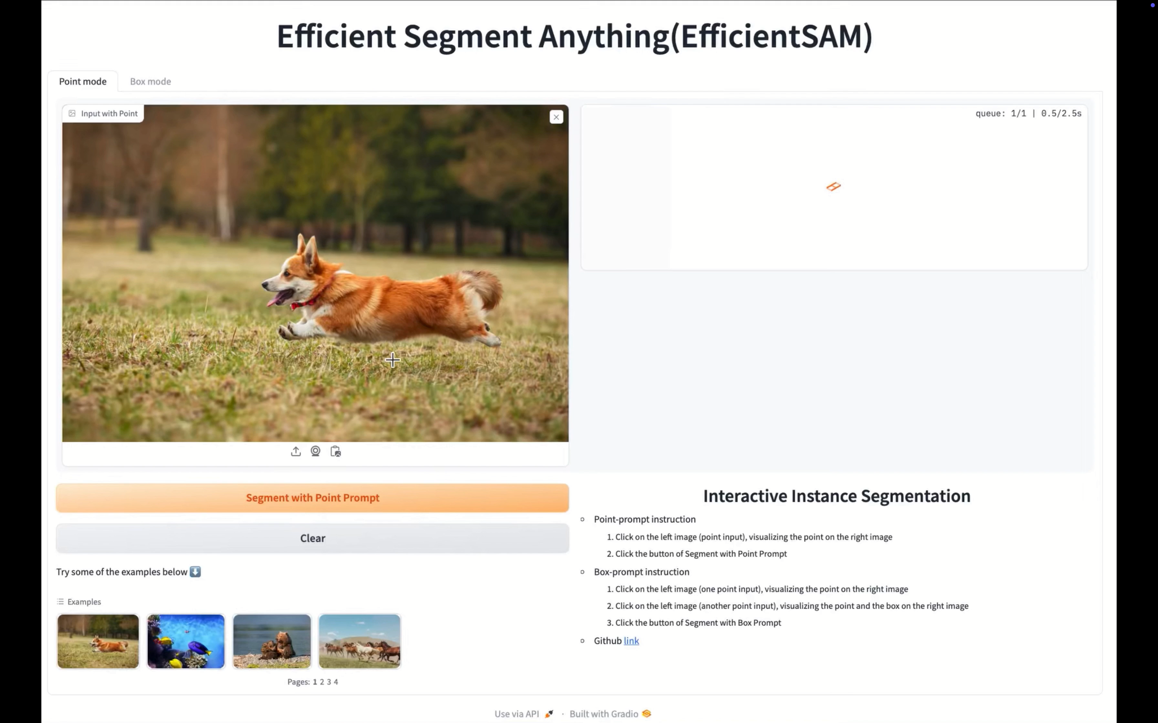
Live
Paper Results:
1. Point-Prompt Segmentation
2. Box-Prompt Segmentation
https://huggingface.co/spaces/yunyangx/EfficientSAM

Slide 14
Model Configuration
Pretraining (SAMI) Details (for Zero-Shot Instance Segmentation):
Loss Function: Uses mean squared error (MSE) loss for reconstruction.
Optimizer Settings: Uses AdamW optimizer with learning rate 2.4e⁻³, momentum parameters β₁ = 0.9, β₂ = 0.95, and weight decay 0.05.
Learning Rate Schedule: Linear warm-up over the first 40 epochs followed by cosine learning rate decay.
Data Augmentation: Employs random resize crop (to 224 × 224), random horizontal flip, and normalization.
Masking & Decoder: A mask ratio of 75% is used, and the decoder consists of 8 Transformer blocks with 512 dimensions.
Pretraining Duration & Hardware: SAMI Pretraining is performed for 400 epochs using the PyTorch framework on V100 machines. For reference, MAE requires 1600 epochs of pretraining.

Slide 15
Model Configuration
Detection & Segmentation Training:
Optimizer Settings: Uses the AdamW optimizer with momentum parameters β₁ = 0.9, β₂ = 0.999 and weight decay 0.1.
Total Training Duration: Model given in paper is trained for 100 epochs.
I trained the model for 40 epochs.
Image Resolution: Input images are resized to 1024 × 1024.
Training Hardware: Models are trained using 64 V100 GPUs.
I used a single RTX A5000 GPU..
Learning Rate Schedule: Initial learning rate of 2e-4 with linear warm-up for the first 10 epochs; decayed to 0 by a cosine schedule.

Slide 16
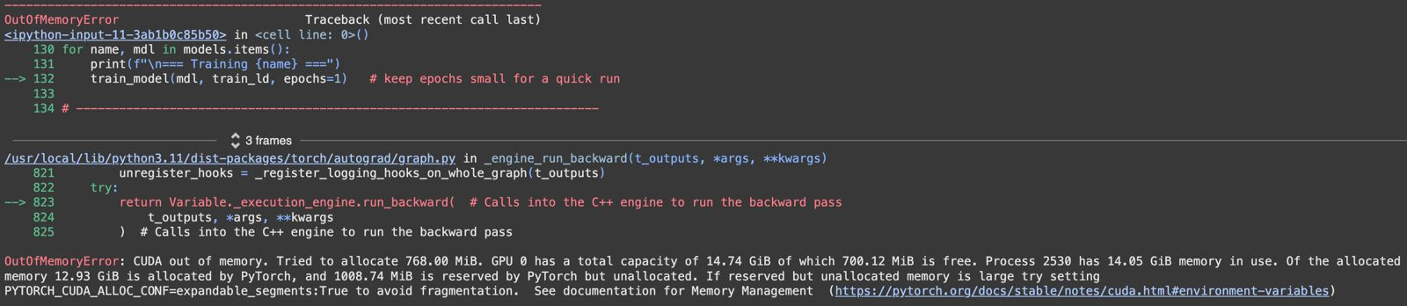
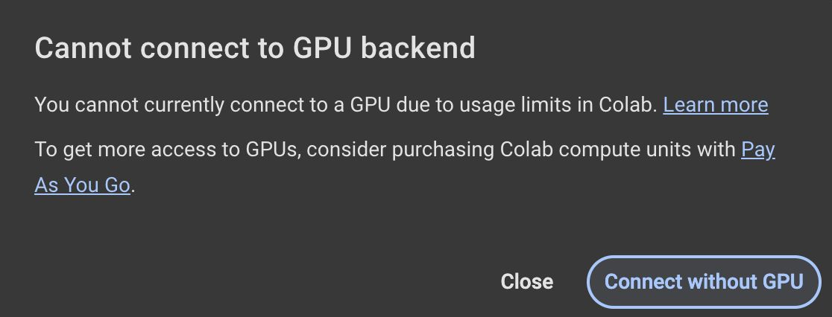
Challenges Faced
Google Colab Runtime error due to full disk.
Kaggle crash down. Also I was unable to edit any file on Kaggle.
Limited accessibility to high end GPU’s.
Persistent Out of Memory error while running the code on Colab and Kaggle
It took approximately 20 hours to test EfficientSAM-Small model on the COCO dataset. So I could test the model only on a subset of the LVIS dataset, which is 4 times the size of COCO dataset.

Slide 17
Paper Results:
Model | COCO mIOU | COCO AP | COCO APL | COCO APM | COCO APS | LVIS mIOU | LVIS AP | LVIS APL | LVIS APM | LVIS APS
EfficientSAM-Tiny | 75.7 | 42.3 | 57.4 | 46.2 | 26.7 | 74.3 | 39.9 | 59.9 | 51 | 28.9
EfficientSAM-Small | 77 | 44.4 | 60.1 | 48.3 | 28.4 | 75.4 | 42.3 | 62.3 | 54 | 30.8
Reproduced Results:
Model | COCO mIOU | COCO AP | COCO APL | COCO APM | COCO APS | LVIS mIOU | LVIS AP | LVIS APL | LVIS APM | LVIS APS
EfficientSAM-Tiny | 69.03 | 45.2 | 57.3 | 49.0 | 38.0 | 64.31 | 32.3 | 49.1 | 40.0 | 20.1
EfficientSAM-Small | 70.73 | 45.2 | 57.1 | 49.0 | 38.2 | 66.54 | 36.1 | 53.3 | 42.2 | 25.2

Slide 18
Reproduced Results: COCO Dataset

Slide 19
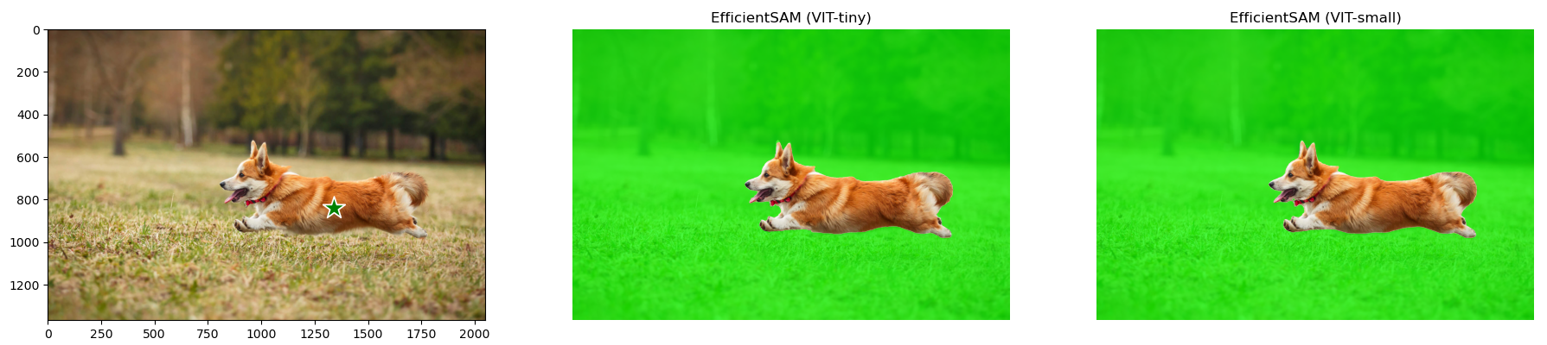
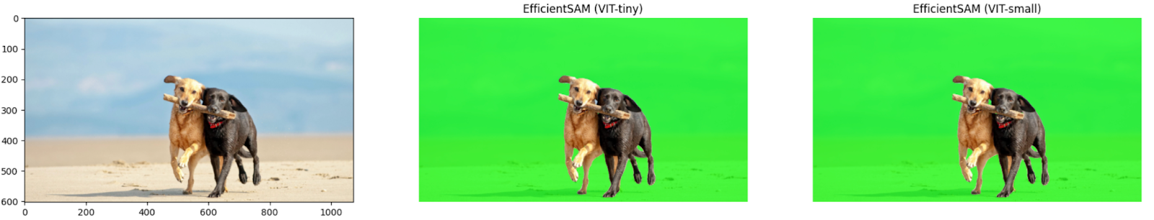
Reproduced Results: Point-Prompt Segmentation
Inference time: 19.1 seconds

Slide 20

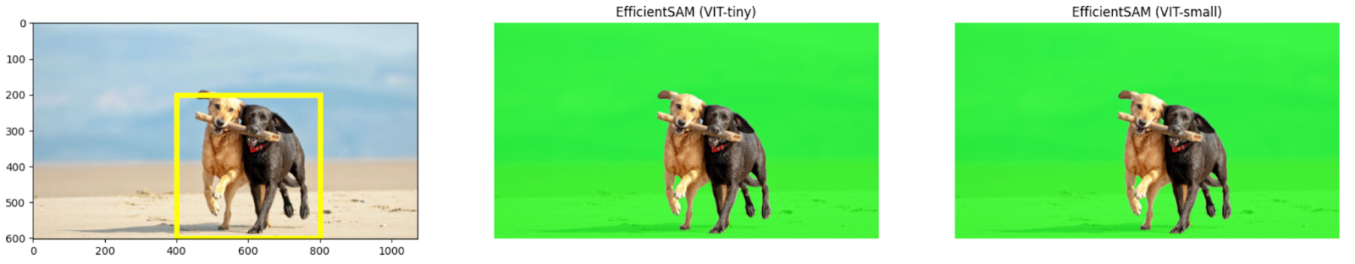
Reproduced Results: Box-Prompt Segmentation
Inference time: 19.3 seconds

Slide 21
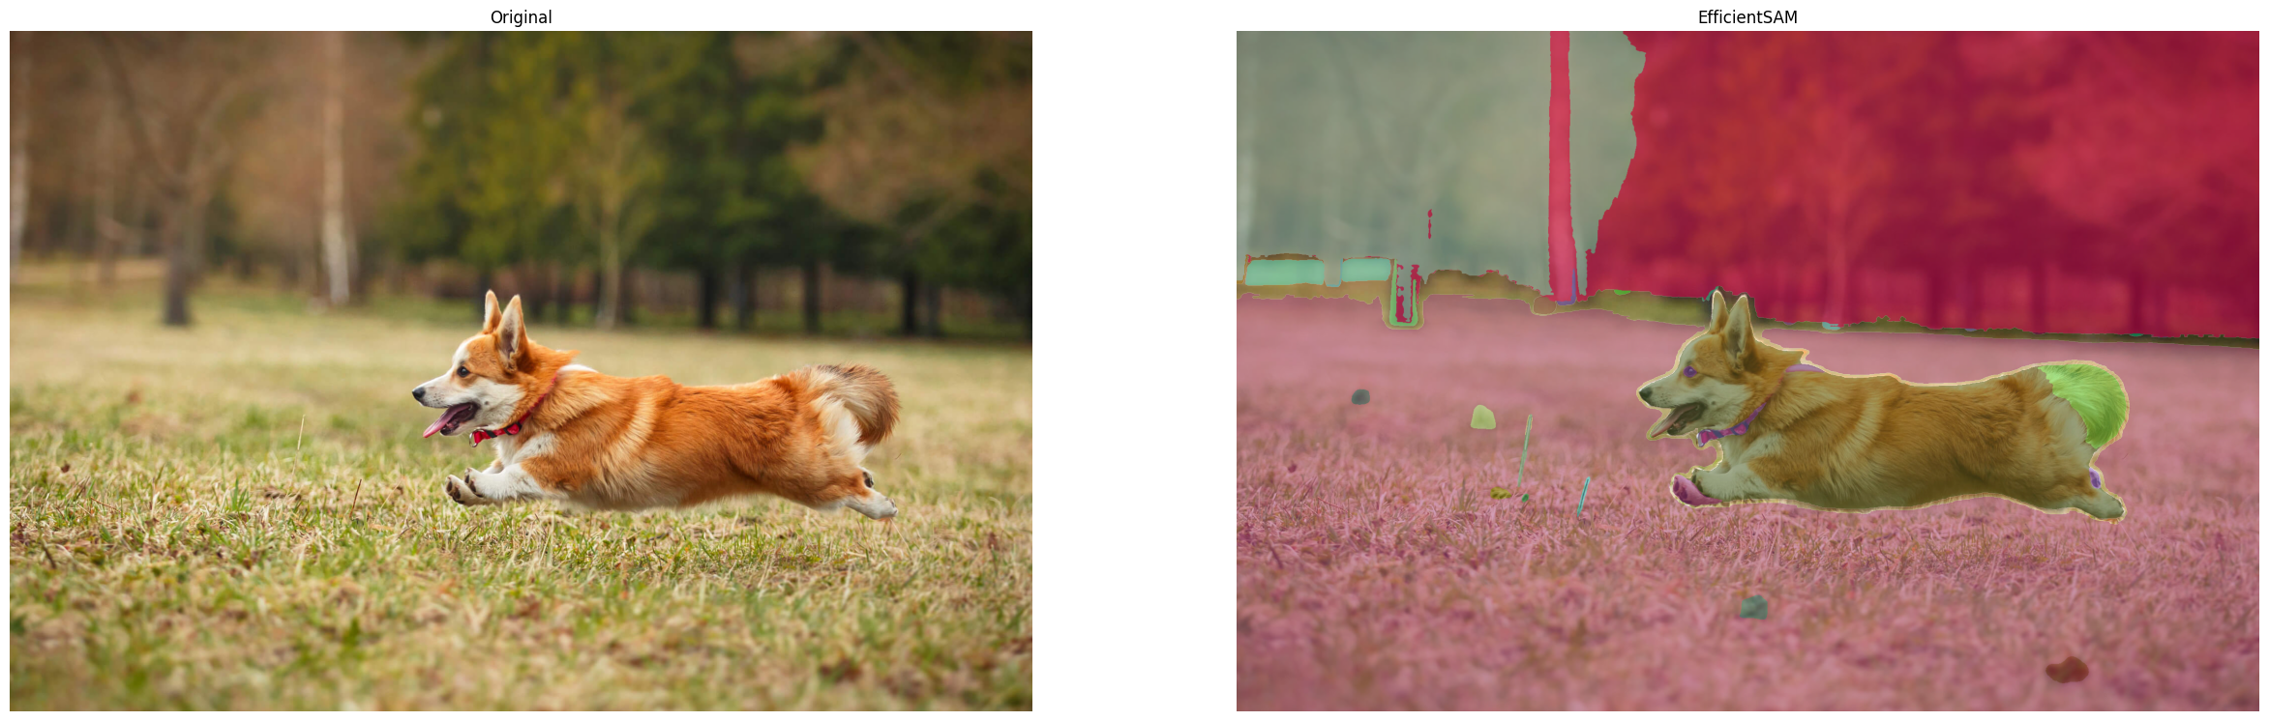
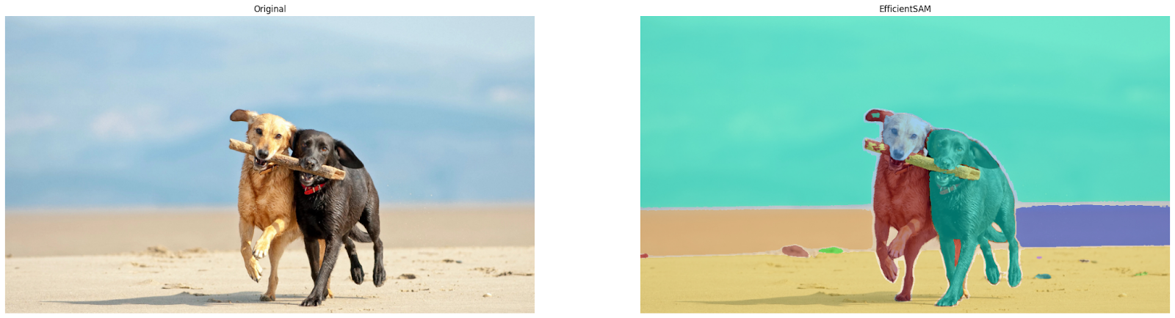
Reproduced Results: Segment Everything

Slide 22
Limitations of EfficientSAM
Trade-off Between Efficiency and Accuracy:
1. EfficientSAM:
Goal: Reduce computational overhead of the original SAM model.
Approach: Implement a lighter, more efficient model architecture.
Model Changes: Uses smaller networks, fewer parameters, simplified layers.
Reason: Original SAM known for high accuracy, but with high computational demands.
2. Consequence:
Efficiency vs. Accuracy: Simplification leads to reduced accuracy.
Detail Limitation: Lightweight models may not capture complex details as effectively as SAM.
Deployment: Works well on low-power devices but may struggle with complex tasks.
Learning Impact: Limits ability to generalize across large, diverse datasets.
Example: In critical applications like medical imaging or complex scene segmentation, reduced model complexity may result in less precise outcomes.

Slide 23
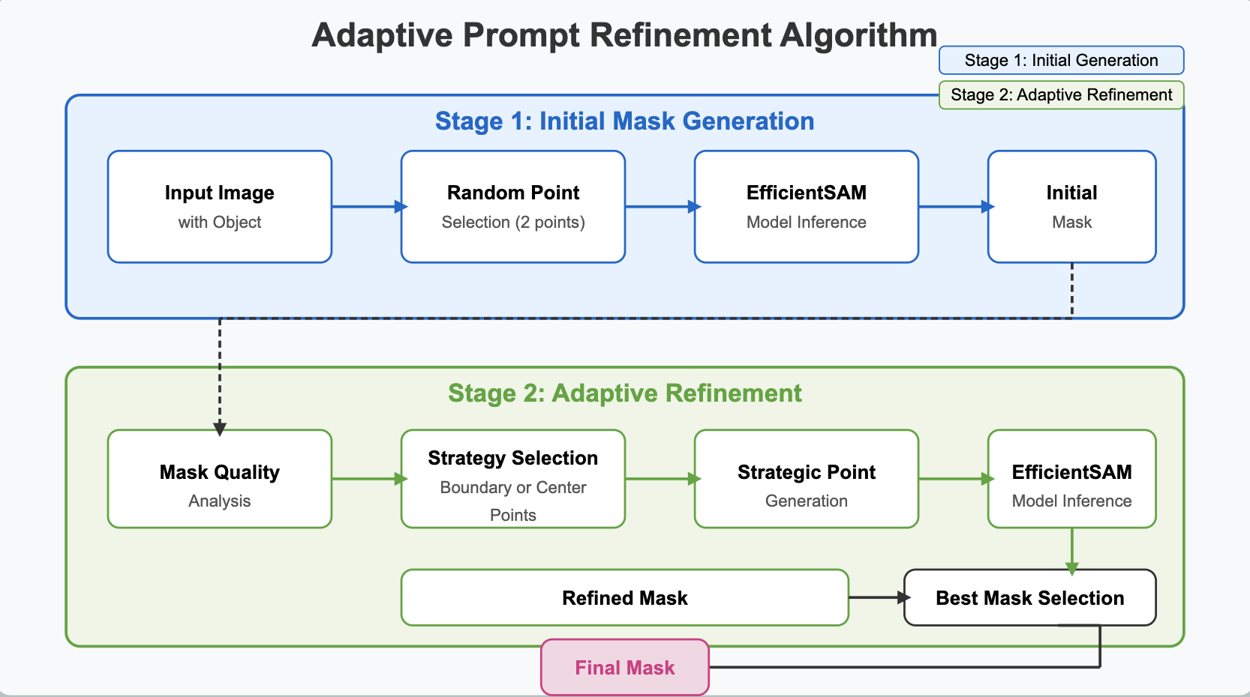
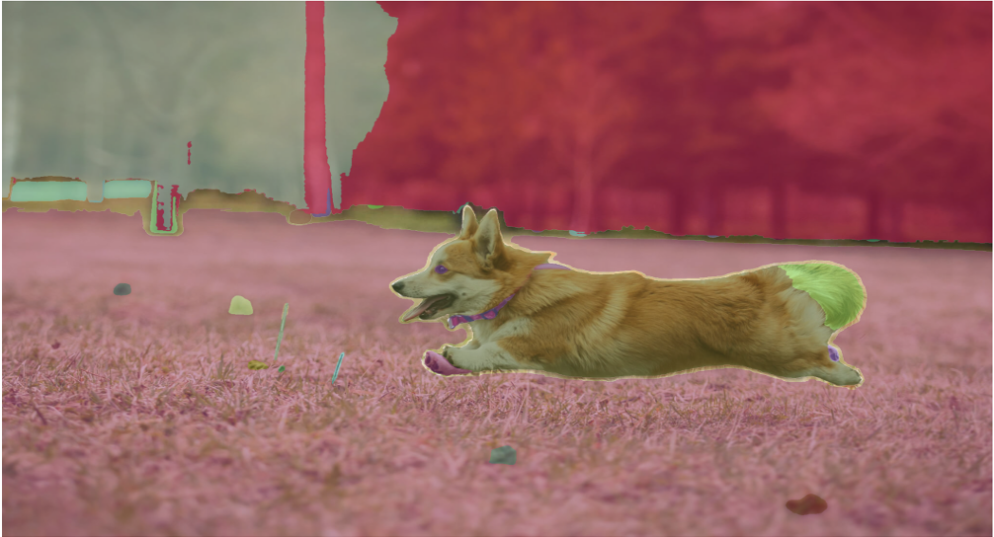
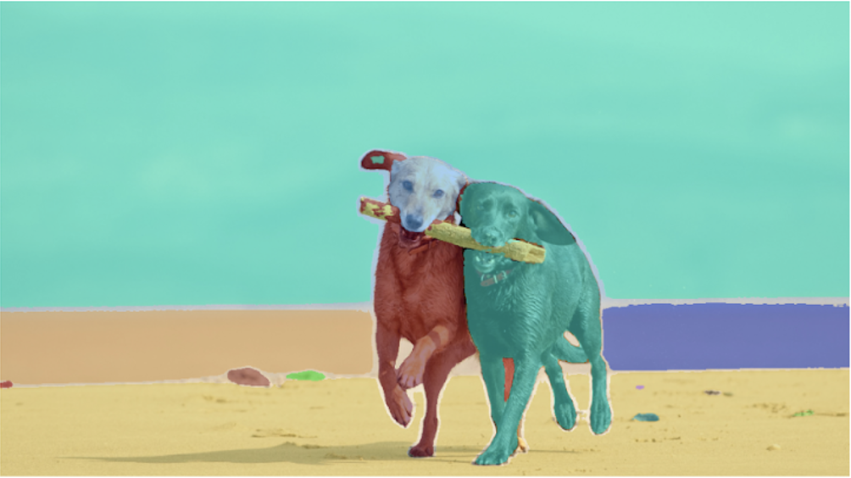
Novelty: Adaptive Prompt Refinement
Two-Stage Process:
Stage 1: Initial Mask Generation
Start with an input image containing the object to segment
Select two random points within the ground truth object
Run these points through the EfficientSAM model
Generate an initial segmentation mask
Stage 2: Adaptive Refinement
Analyze the quality of the initial mask (checking connectedness, boundaries, compactness)
Select a refinement strategy based on analysis:
For disconnected components → Choose center-based strategy
For irregular boundaries → Choose boundary-based strategy
Generate strategic point prompts based on the chosen strategy
Run EfficientSAM again with these strategic points
Produce a refined mask
Compare initial and refined masks, selecting the better one as the final output
Irregular boundary
Regular boundary

Slide 24
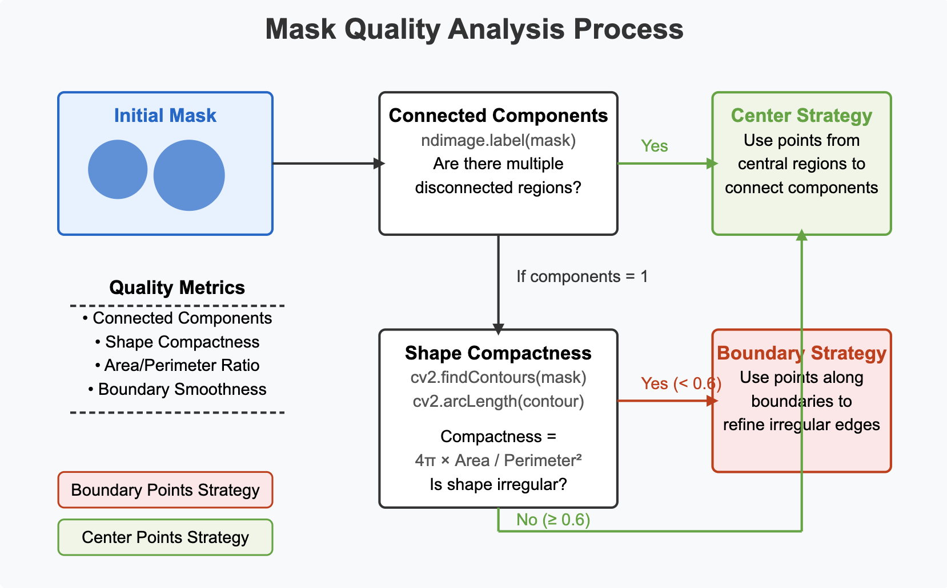
Novelty: Mask Quality Analysis phase
Connected Components Analysis:
Using ndimage.label(mask) to detect if the mask contains multiple disconnected regions.
Shape Compactness Analysis:
Contour Extraction:
Uses cv2.findContours(mask) with cv2.RETR_EXTERNAL flag to extract only outer contours
cv2.CHAIN_APPROX_SIMPLE compresses horizontal, vertical, and diagonal segments, storing only their end points
Calculates perimeter using cv2.arcLength(contour) with True flag for closed contours.
Calculating the isoperimetric quotient (4π × Area / Perimeter²) to measure shape irregularity.
Decision Logic: If multiple components are detected → Use Center Points Strategy
If shape is irregular (compactness < 0.6) → Use Boundary Points Strategy
If shape is compact (compactness ≥ 0.6) → Use Center Points Strategy

Slide 25
Novelty: Mask Quality Analysis phase
Connected Components Analysis:
Using ndimage.label(mask) to detect if the mask contains multiple disconnected regions.
Shape Compactness Analysis:
Contour Extraction:
Uses cv2.findContours(mask) with cv2.RETR_EXTERNAL flag to extract only outer contours
cv2.CHAIN_APPROX_SIMPLE compresses horizontal, vertical, and diagonal segments, storing only their end points
Calculates perimeter using cv2.arcLength(contour) with True flag for closed contours.
Calculating the isoperimetric quotient (4π × Area / Perimeter²) to measure shape irregularity.
Decision Logic: If multiple components are detected → Use Center Points Strategy
If shape is irregular (compactness < 0.6) → Use Boundary Points Strategy
If shape is compact (compactness ≥ 0.6) → Use Center Points Strategy

Slide 26
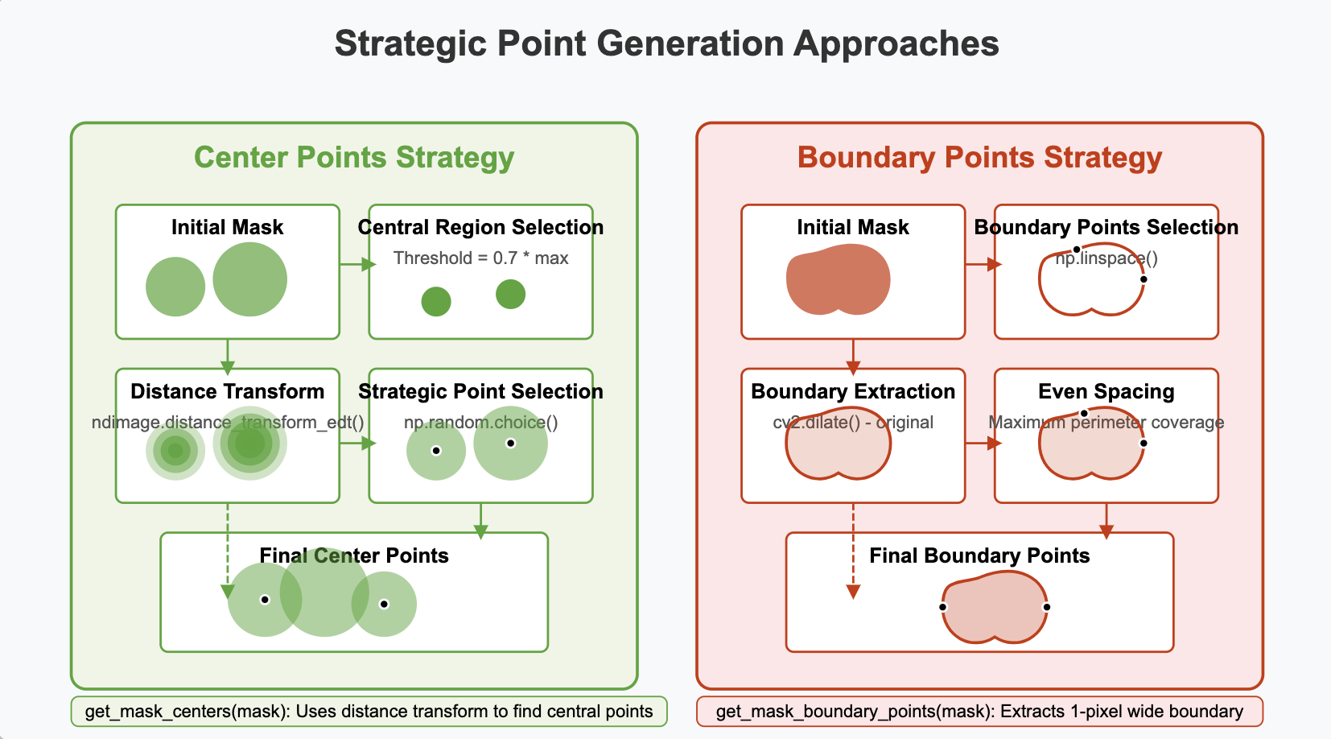
Novelty: Strategic Point Generation phase
Center Points Strategy:
Distance Transform:
Uses distance transform (ndimage.distance_transform_edt()) to calculate how far each pixel is from the mask boundary
For each foreground pixel, calculates distance to the nearest background pixel
Creates a gradient map where higher values indicate deeper positions inside the mask
Adaptive Thresholding:
Applies a threshold to select the deepest interior regions (70% of maximum distance) dynamically.
Strategic Point Selection:
Samples points from these central regions using np.random.choice()
Points are selected from the deepest parts of the mask, maximizing distance from boundaries
Ideal for connecting disconnected components and handling compact shapes

Slide 27
Novelty: Strategic Point Generation phase
Boundary Points Strategy:
Boundary Extraction:
Applies cv2.dilate() with a 3×3 kernel to expand the mask by 1 pixel in all directions
Creates a 1-pixel wide boundary using morphological operations (cv2.dilate() - original)
Point Sampling:
Obtains coordinates of all boundary pixels using np.where(boundary > 0)
Selects points with maximum spacing using np.linspace()
The technique ensures points are distributed evenly around the perimeter
Automatically adapts to arbitrary boundary shapes
Ensures maximum perimeter coverage for better edge definition
Particularly effective for refining irregular boundaries and complex shapes

Slide 28
Novelty Results: COCO Dataset
Model | COCO mIOU | COCO AP | COCO APL | COCO APM | COCO APS
EfficientSAM-Tiny | 75.55 | 54.7 | 68.5 | 59.2 | 44.7
EfficientSAM-Small | 75.17 | 52.8 | 67.4 | 57.4 | 42.7
Improved the performance of the model
Improved the quality of the masks produced
In almost comparable amount of time (O(N) vs O(2N))

Slide 29
Novelty Results: COCO Dataset

Slide 30
Novelty Results: COCO Dataset

Slide 31
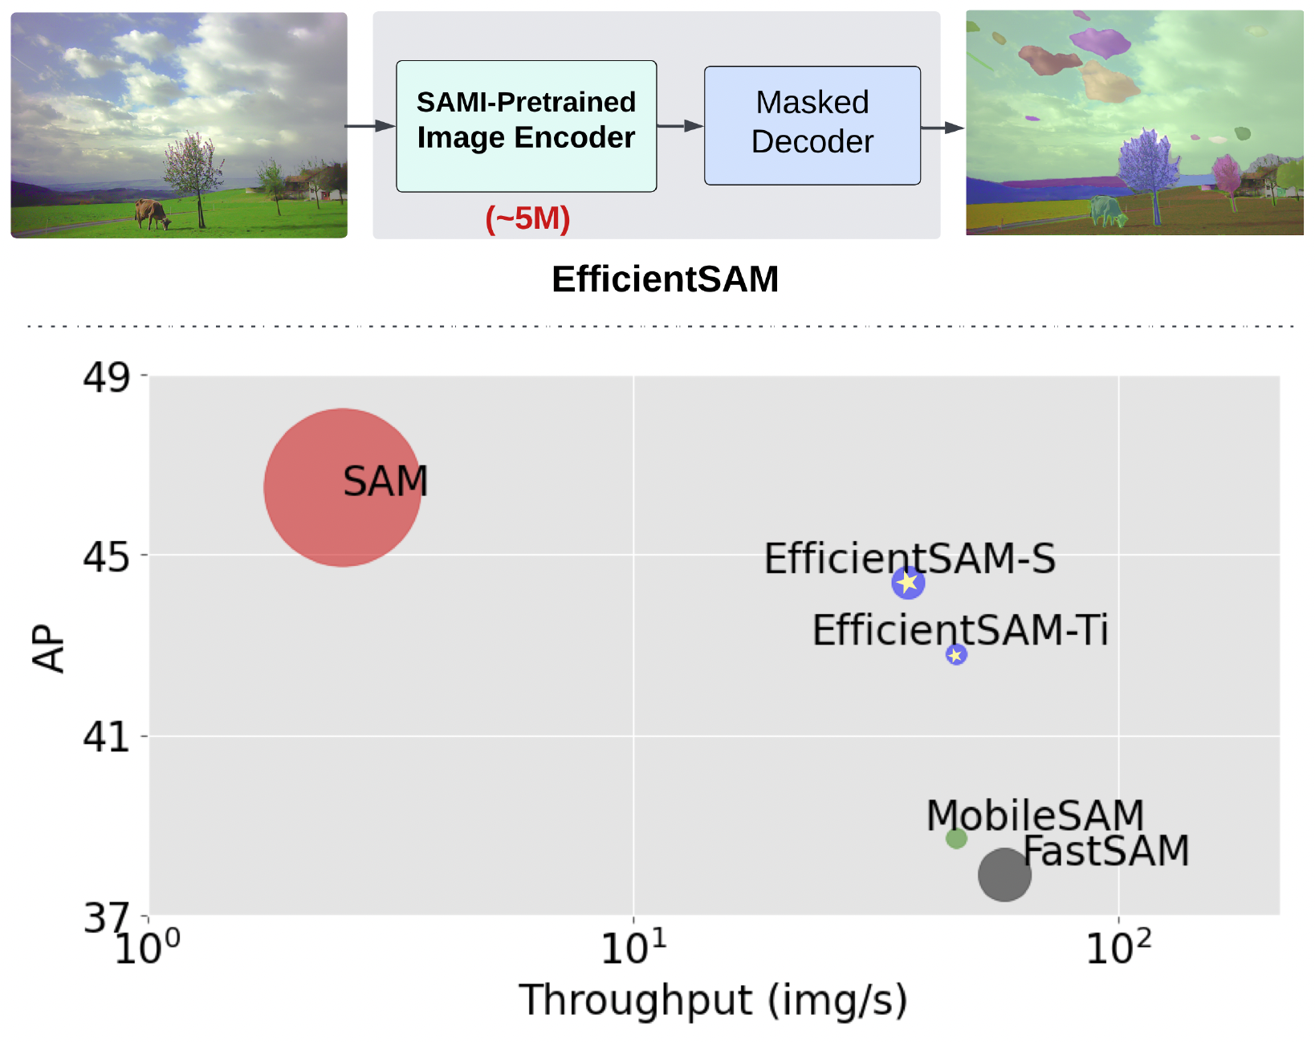
Conclusion
SAMI (SAM-leveraged Masked Image Pretraining) enhances ViTs by leveraging the SAM foundation model.
Improves pretraining by reconstructing latent features from SAM’s image encoder.
Proven effective across tasks: image classification, object detection, instance segmentation, semantic segmentation, and segment anything.
EfficientSAM-S reduces the inference time of SAM by ∼20x and the parameter size by ∼20x with a small performance drop, 44.4 AP vs 46.5 AP.
Performance for Zero-Shot Instance Segmentation on COCO dataset.

Slide 32
References
SAM (Segment Anything Model) – Kirillov et al., "Segment Anything Model," 2023.
Masked Autoencoders (MAE) – He et al., "Masked Autoencoders Are Scalable Vision Learners," 2022.
Vision Transformers (ViTs) – Dosovitskiy et al., "An Image is Worth 16x16 Words: Transformers for Image Recognition at Scale," 2020.
Knowledge Distillation – Hinton et al., "Distilling the Knowledge in a Neural Network," 2015.
Self-Supervised Pretraining (BEiT, iBOT, DINO, CAE, etc.) – Bao et al., "BEiT: BERT Pre-Training of Image Transformers," 2021.
FastSAM & MobileSAM – Yang et al., "Fast Segment Anything," 2023; Li et al., "MobileSAM: Lightweight Segment Anything Model," 2023.
Mask2Former (Semantic Segmentation) – Cheng et al., "Mask2Former: Masked-Attention Transformer for Universal Image Segmentation," 2021.
ViTDet (Object Detection with Vision Transformers) – Li et al., "Exploring Plain Vision Transformer Backbones for Object Detection," 2022.
U²-Net (Saliency-based Segmentation) – Qin et al., "U²-Net: Going Deeper with Nested U-Structure for Salient Object Detection," 2020.

Slide 33

Thank You

